Slide 1
UNIT CONVERTOR
-Ayush Kale (I1) , Ayush Sisodiya (I1) & Yaman Gupta(I2)

Slide 2
Objective
To create a Unit Convertor for multiple dimensions.

Slide 3
Modules Built

Slide 4


Slide 5
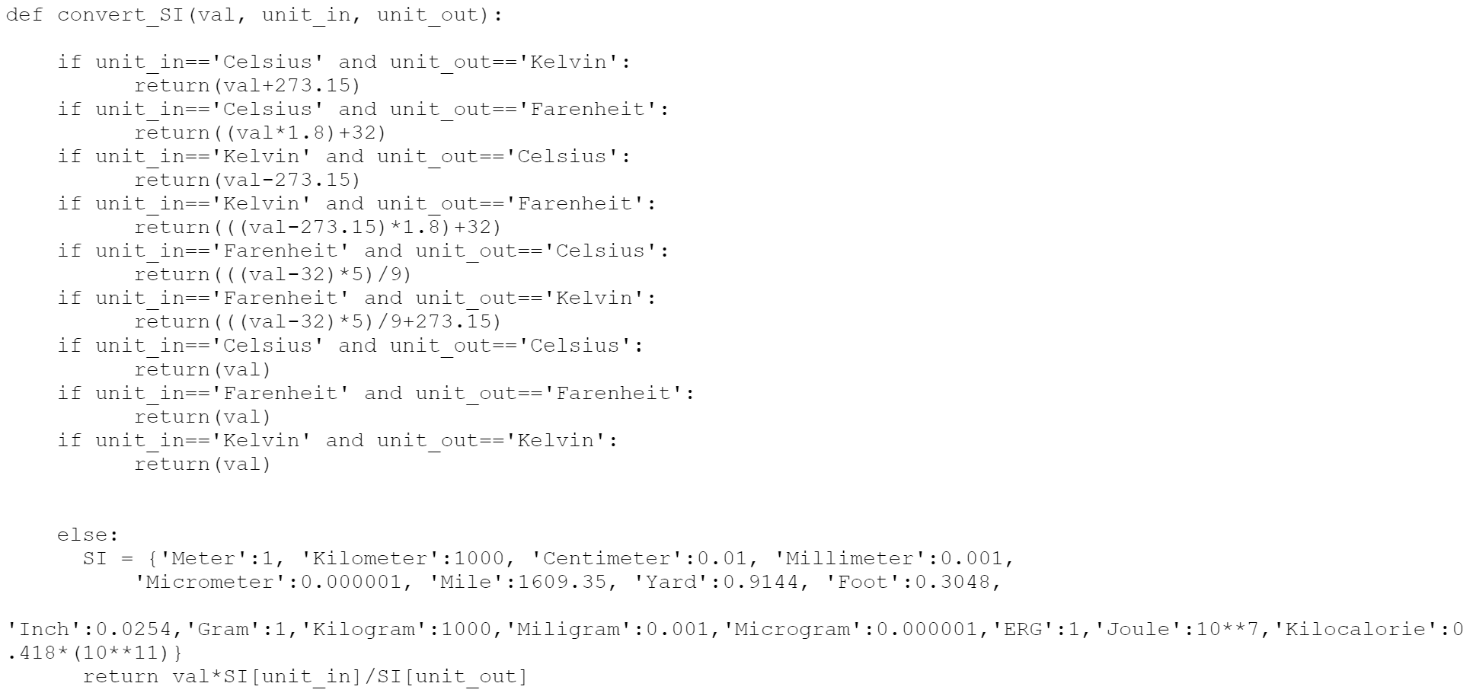

Slide 6


Slide 7


Slide 8


Slide 9
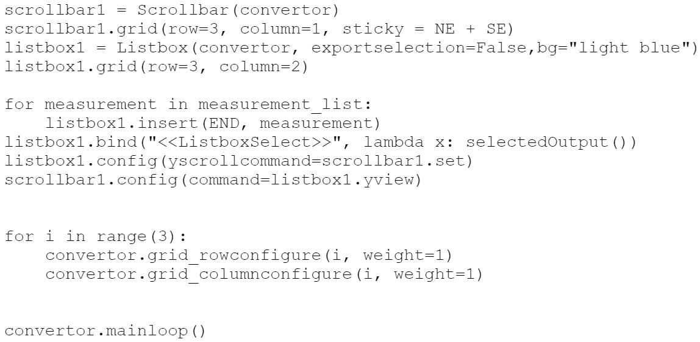

Slide 10
Snapshots

Slide 11
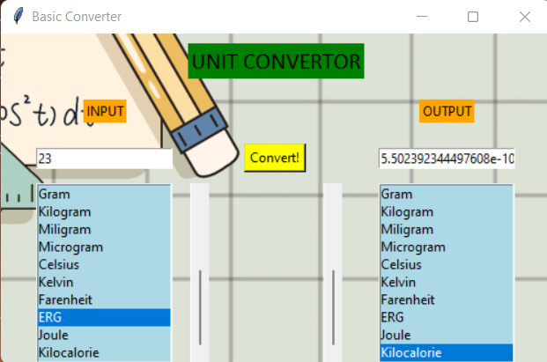

Slide 12
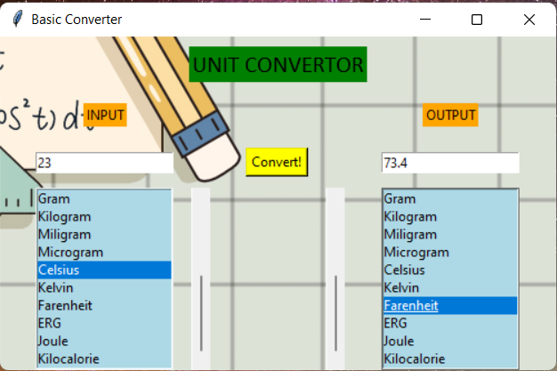

Slide 13
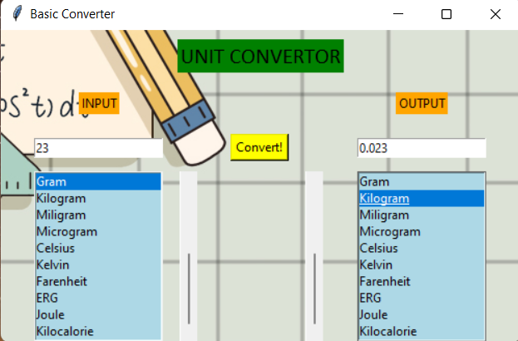

Slide 14
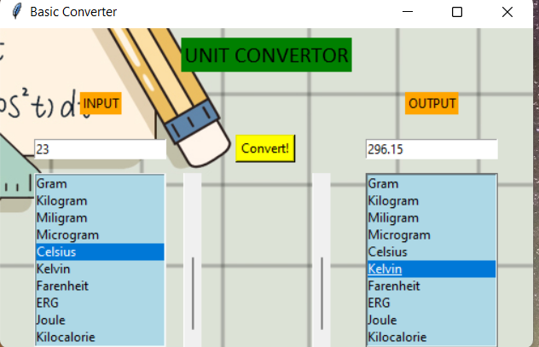

Slide 15
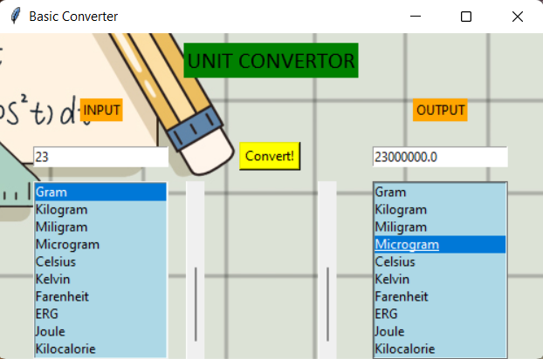

Slide 16
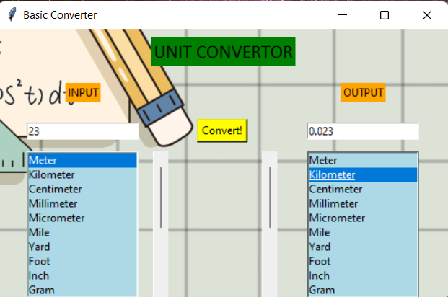

Slide 17
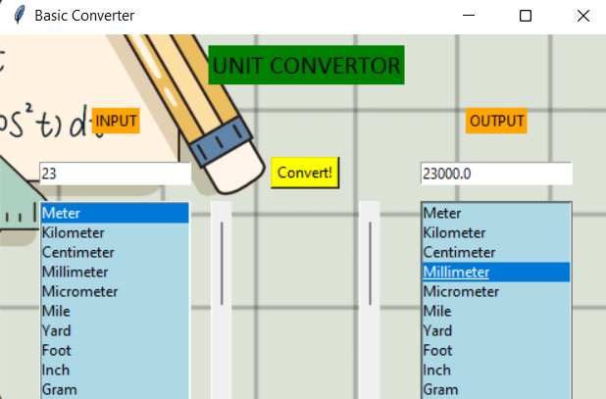

Slide 18
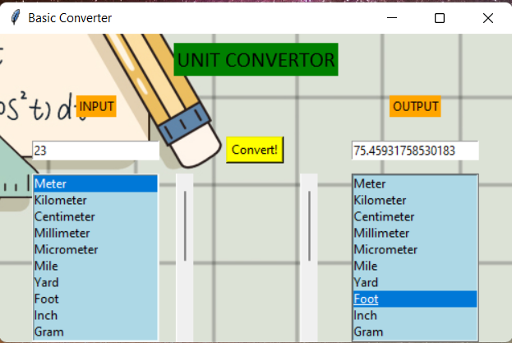

Slide 19
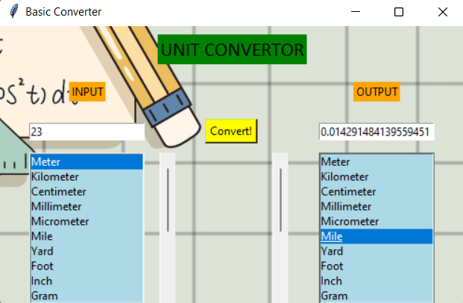

Slide 20
